Slide 1
Metropolitan Area Networks access methods
Fiber Distributed Data Interface (FDDI)

Slide 2
Why MANs?
Developed because of the need for intermediate networks that operate over a metropolitan area with high data rates.
  With some characteristics of LANs and some of WANs
    LAN is used to connect over short distance.
    WAN provides long haul communication

Slide 3
Definition of MANs
Is a means of enabling diverse computing devices to communicate over a high speed links within a city-wide area
A supernetwork that represents LAN technology optimized for the longer distances (nominally 50-km diameter) and using access protocols less sensitive to network size than those of LANs
  Collisions from contention
  Latency from token passing

Slide 4
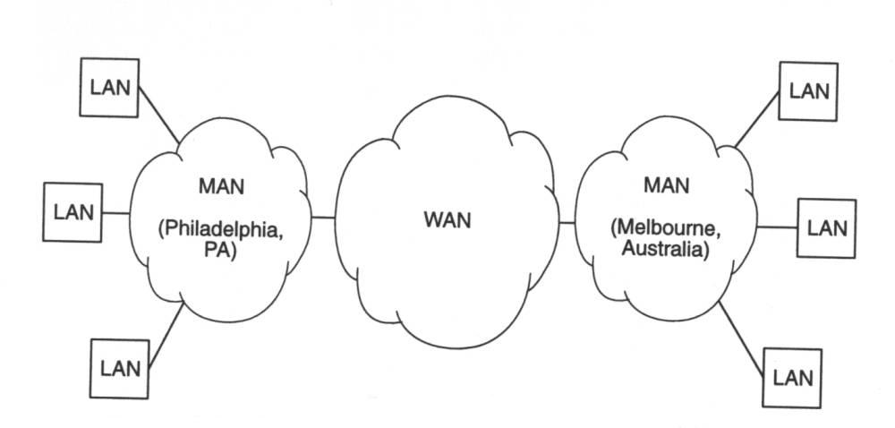
Interconnection of LANs, MANs, and WANs

Slide 5
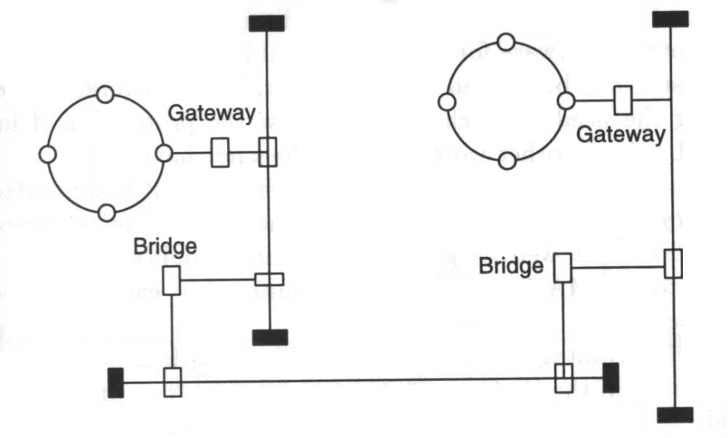
LAN-Based MANs
For LAN-Based MANs, interconnection of the existing LANs is achieved either directly or through a backbone network

Slide 6
FDDI - Background
Benefits of optical fibers over copper technology
FDDI is an ANSI standard a high speed network for an interconnection of computer and peripheral equipment
Proposed by ANSI as a dual token ring that supports data rates of 100 Mbps and uses optical fiber media

Slide 7
FDDI – Basic Features
Is both an interface technology and a protocol
Media: 1300nm, optical fibers.
Transmission Method: Baseband.
Data Rate: 100Mbps.
Maximum distance between adjacent stations/nodes: 2 km.
Total maximum ring length: 100 km.
Topology: physical ring of trees, logical ring
  Dual ring, wrapped ring with or without trees, and single tree.

Slide 8
FDDI – Basic Features
Number of nodes: 500
Classes of service: The FDDI MAC supports
  Asynchronous – Normal bursty traffic
  Synchronous – More constant traffic - Guaranteed bandwidth to each station on each token rotation.
  Restricted asynchronous – Mechanism for extended and protected dialog between a limited number of stations.

Slide 9
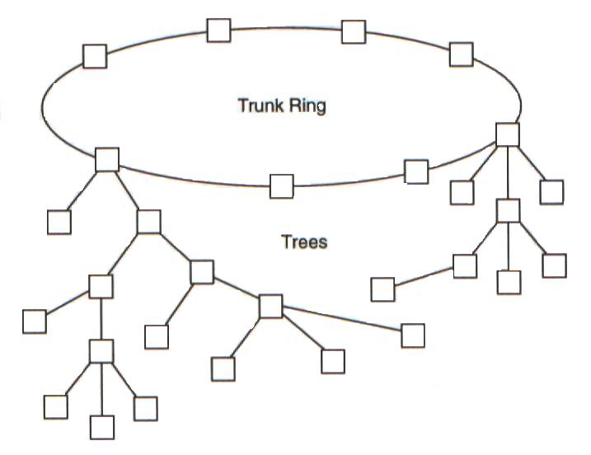
FDDI – ring-of-trees topology

Slide 10
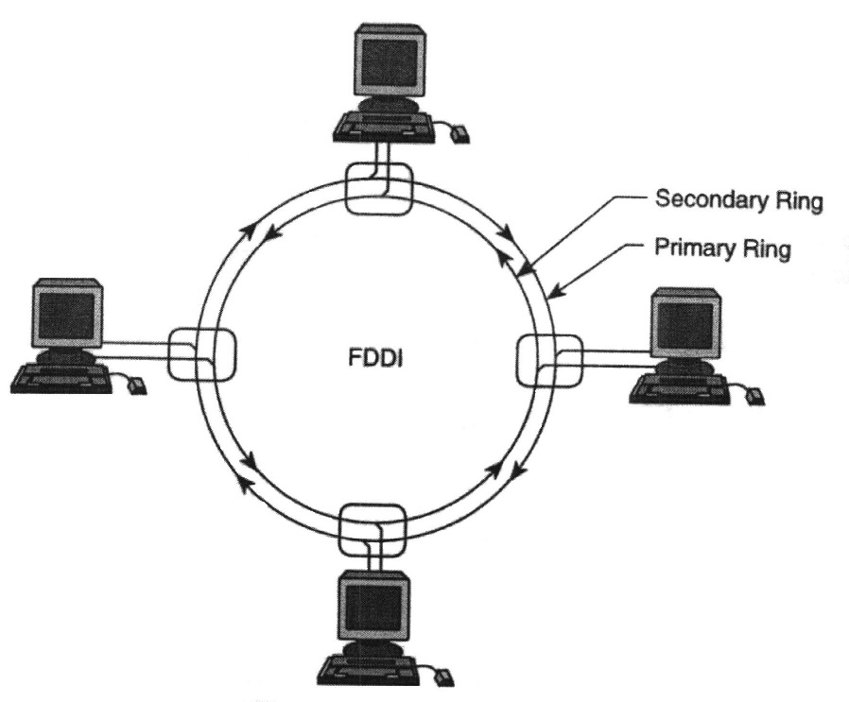
FDDI – Ring operation
FDDI network consists of two counter-rotating rings (traffic on each ring flows in opposite direction).
  Primary ring – Used during normal operation for data transmission.
  Secondary ring – Provides an alternate data path in the event of a fault occurring on the primary ring.

Slide 11
FDDI station attachment types
Single Attachment Stations (SAS)
  Attaches to only one ring (the primary) through a concentrator.
  Device will not have any effect on the ring if powered off or disconnected.
Dual Attachment Stations (DAS)
  Have two ports designated A and B.
  The ports connect the DASs to the dual FDDI ring.
  They affect the ring if disconnected or powered off.
Concentrator (Dual Attachment Concentrator – DAC)
  The building block of the FDDI network.
  Attaches to both rings.
  Ensures that the failure or power-down of any SAS does not bring down the ring.

Slide 12
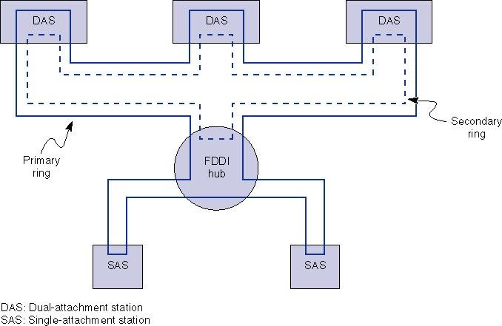
FDDI station attachment types
Concentrator

Slide 13
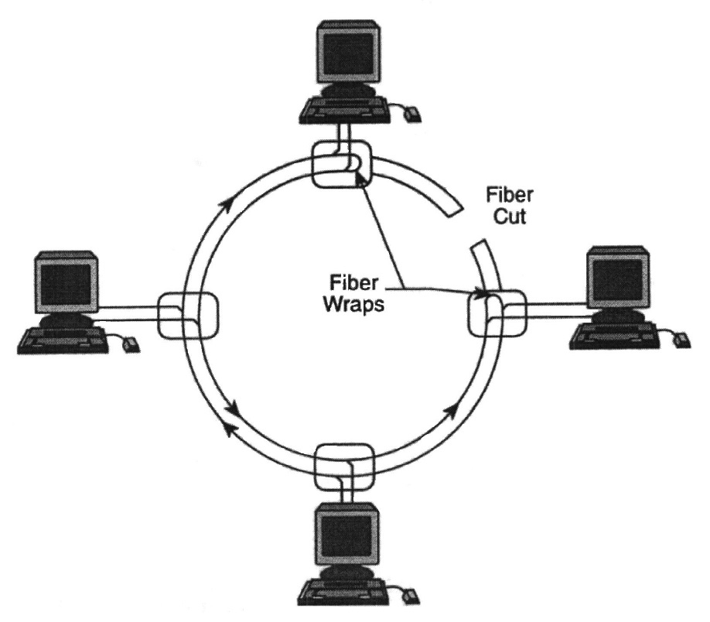
FDDI fault isolation
Dual Ring: This is the primary FDDI fault tolerant feature. It comes into effect if:
  The cable is damaged.
  The dual ring fails or is powered down
Optical Bypass Switch: Provides continual dual-ring operation if a device on the dual ring fails.
  Prevents high segmentation
  Eliminates failed stations.
Dual Homing
  The critical devices are attached to two concentrators.
  One pair of the concentrator links is declared the active link and the other the passive link.

Slide 14
FDDI – OSI reference model
4 standard layers
  MAC – Medium Access Control Layer
  PHY – Physical (or signal) Layer
  PMD – Physical Medium Dependent Layer
  SMT – Station Management
OSI
FDDI
Data Link
Layer
LLC
MAC
SMT
Physical
Layer
PHY
PMD

